Slide 1
Probability Distributions
Continuous

Slide 2
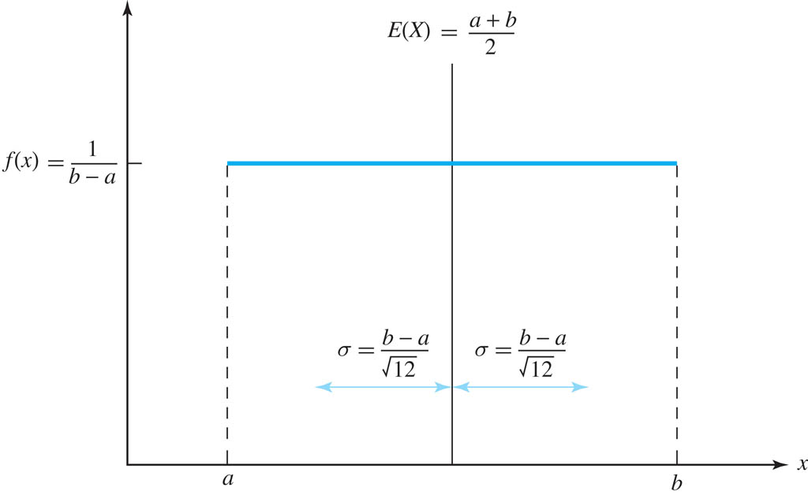
Uniform Distribution
The uniform distribution is a probability distribution that has equal probabilities for all possible outcomes of the random variable
Figure: Probability density function of a U(a, b) distribution
6-<number>

Slide 3
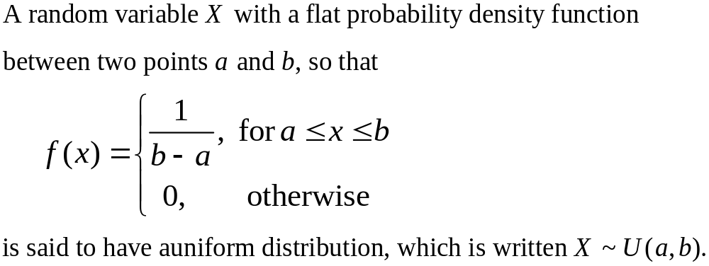
Uniform Distribution
The uniform distribution is a probability distribution that has equal probabilities for all possible outcomes of the random variable.
6-<number>

Slide 4
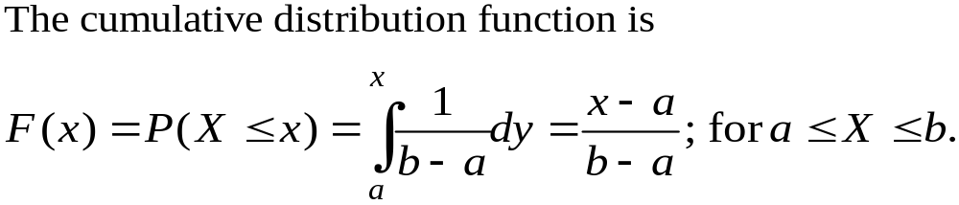
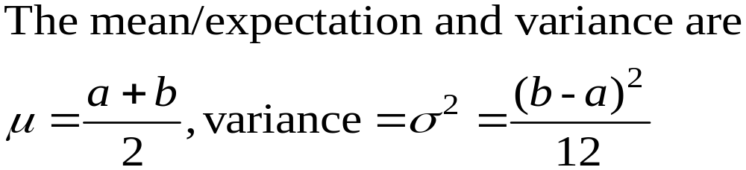
Uniform Distribution
Importance: Uniform distribution plays a crucial role in generating random numbers for various applications. They are used in cryptography, Monte Carlo simulations, statistical modeling, Randomized clinical trials, quality control and many other areas where randomness is required.
CDF of any distribution follows U(0, 1).
6-<number>

Slide 5
Uniform Distribution (Problems, Anthony)
4.1.1 Suppose that X ∼ U(−3, 8). Find:
(a) E(X)
(b) The standard deviation of X
(c) The upper quartile of the distribution
(d) P(0 ≤ X ≤ 4)
Solution:
6-<number>

Slide 6
Uniform Distribution (Problems, Anthony) cont.
4.1.2 A new battery supposedly with a charge of 1.5 volts actually has a voltage with a uniform distribution between 1.43 and 1.60 volts.
(a) What is the expectation of the voltage?
(b) What is the standard deviation of the voltage?
(c) What is the cumulative distribution function of the voltage?
(d) What is the probability that a battery has a voltage less than 1.48 volts?
(e) If a box contains 50 batteries, what are the expectation and variance of the number of batteries in the box with a voltage less than 1.5 volts?
Solution:
6-<number>

Slide 7
Uniform Distribution (Problems, Anthony) cont.
4.1.3 A computer random-number generator produces numbers that have a uniform distribution between 0 and 1.
(a) If 20 random numbers are generated, what are the expectation and variance of the number of them that lie in each of the four intervals [0.00, 0.30), [0.30, 0.50), [0.50, 0.75), and [0.75, 1.00)?
(b) What is the probability that exactly five numbers lie in each of the four intervals?
Solution:
6-<number>

Slide 8
Uniform Distribution (Problems, Anthony) cont.
4.1.4 The lengths in meters of pieces of scrap wood found on a building site are uniformly distributed between 0.0 and 2.5.
(a) What are the expectation and variance of the lengths?
(b) What is the probability that at least 20 out of 25 pieces of scrap wood are longer than 1 meter?
Solution:
6-<number>

Slide 9
Uniform Distribution (Problems, Anthony) cont.
4.1.5 Suppose that a metal pin has a diameter that has a uniform distribution between 4.182 mm and 4.185 mm.
(a) What is the probability that a pin will fit into a hole that has a diameter of 4.184 mm?
(b) If a pin does fit into the hole, what is the probability that the difference between the diameter of the hole and the diameter of the pin is less than 0.0005 mm?
6-<number>

Slide 10
Uniform Distribution (Problems, Anthony) cont.
4.1.6 When employees undergo an evaluation, their scores are independent and uniformly distributed between 60 and 100.
(a) If six employees take the evaluation, what is the probability that half of them score more than 85 and half less?
(b) If six employees take the evaluation, what is the probability that two of them score less than 80, two of them score between 80 and 90, and the remaining two score more than 90?
(c) If the employees are tested sequentially, what is the expected number of employees who need to be tested before three are found with scores higher than 90?
Solution:
6-<number>

Slide 11
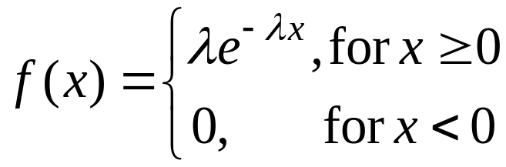
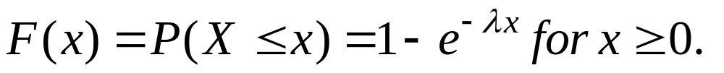
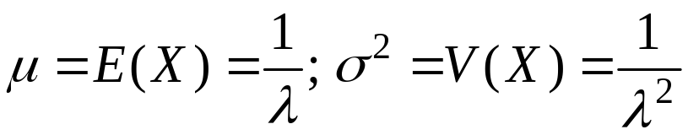
The Exponential Distribution
An exponential distribution with parameter λ > 0 has a probability density function
The cumulative distribution function (CDF):
It is useful for modeling failure times and waiting times.
Examples:
    Time between trucks arriving at an unloading dock
    Time between transactions at an ATM Machine
    Time between phone calls to the main operator

Slide 12
Problems on Exponential distribution (Anthony)
4.2.2 Suppose that you are waiting for a friend to call you and that the time you wait in minutes has an exponential
distribution with parameter λ = 0.1.
(a) What is the expectation of your waiting time?
(b) What is the probability that you will wait longer than 10 minutes?
(c) What is the probability that you will wait less than 5 minutes?
Solution:

Slide 13
Problems on Exponential distribution (Anthony)
4.2.2 Suppose that you are waiting for a friend to call you and that the time you wait in minutes has an exponential distribution with parameter λ = 0.1.
(a) What is the expectation of your waiting time?
(b) What is the probability that you will wait longer than 10 minutes?
(c) What is the probability that you will wait less than 5 minutes?
(d) Suppose that after 5 minutes you are still waiting for the call. What is the distribution of your additional waiting time? In this case, what is the probability that your total waiting time is longer than 15 minutes?
(e) Suppose now that the time you wait in minutes for the call has a U(0, 20) distribution. What is the expectation of your waiting time? If after 5 minutes you are still waiting for the call, what is the distribution of your additional waiting time?
Solution:

Slide 14
Problems on Exponential distribution (Anthony)
4.2.3 The time in days between breakdowns of a machine is exponentially distributed with λ = 0.2.
(a) What is the expected time between machine breakdowns?
(b) What is the standard deviation of the time between machine breakdowns?
(c) What is the median time between machine breakdowns?
(d) What is the probability that after the machine is repaired, it lasts at least a week before failing again?
(e) If the machine has performed satisfactorily for six days, what is the probability that it lasts at least two more days before breaking down?
Solution:

Slide 15
Problems on Exponential distribution (Anthony)
4.2.4 A researcher plants 12 seeds whose germination times in days are independent exponential distributions with λ = 0.31.
(a) What is the probability that a given seed germinates within five days?
(b) What are the expectation and variance of the number of seeds germinating within five days?
c) What is the probability that no more than nine seeds have germinated within five days?
Solution:

Slide 16

Relationship between Exponential and Uniform distribution

